Slide 1
2018 Baja Wheel Hub
Jon Ferris, Clay Freeman

Slide 2
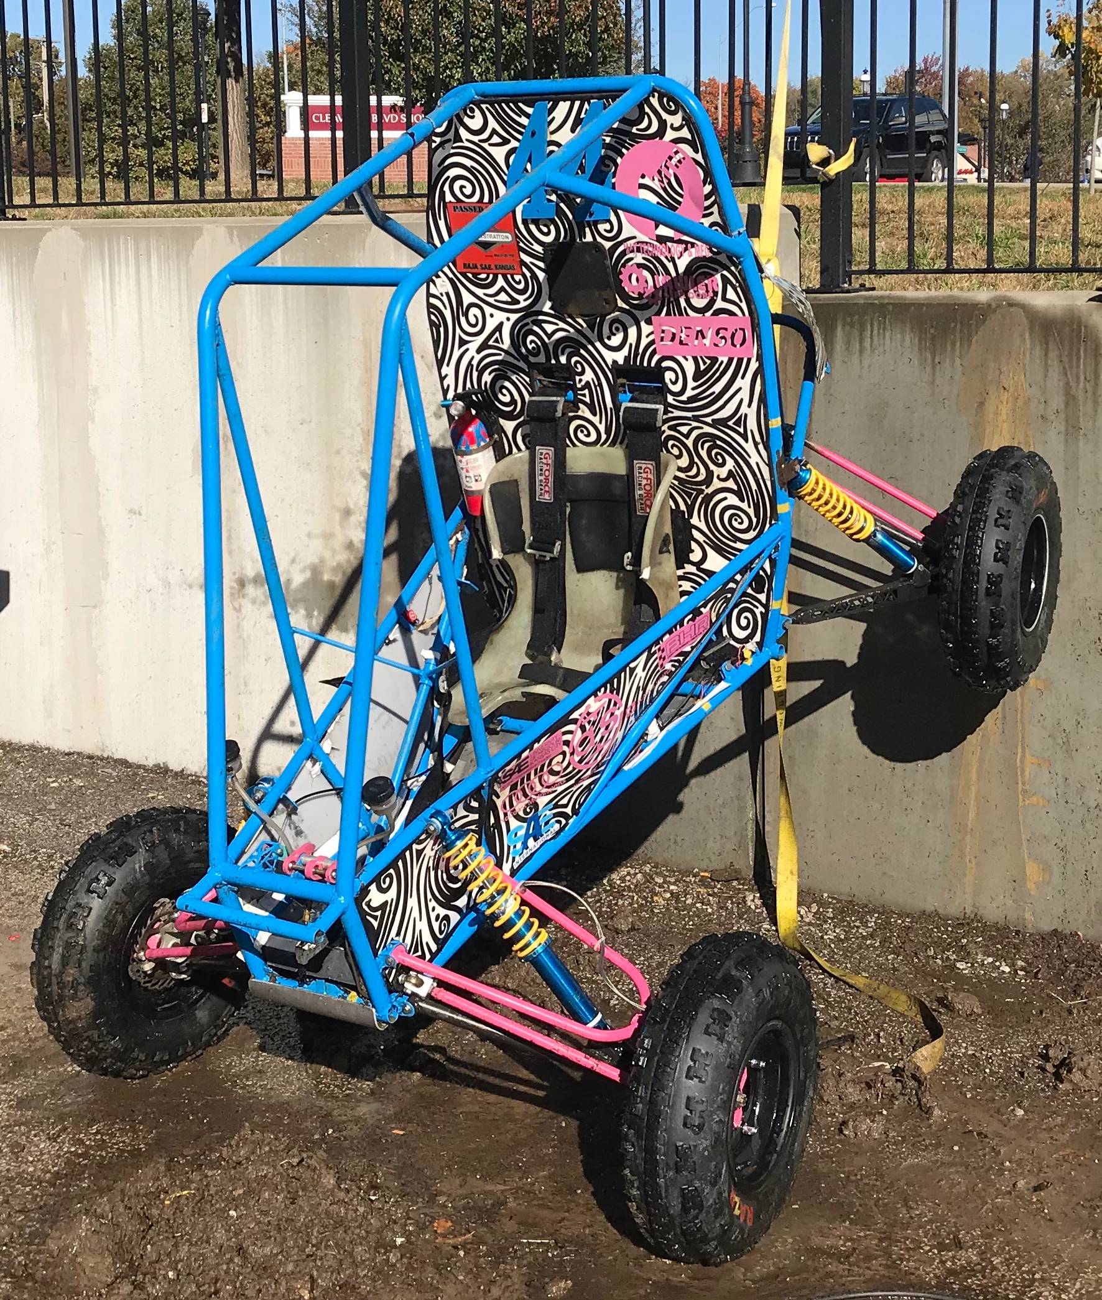
Customer Definition
2018 UMKC SAE Baja Racing Team
People who could use a vehicle to haul a person and gear to a small area in rugged terrain.
Hobbyist drivers of all terrain type vehicles that like to upgrade to high performance and custom parts.

Slide 3
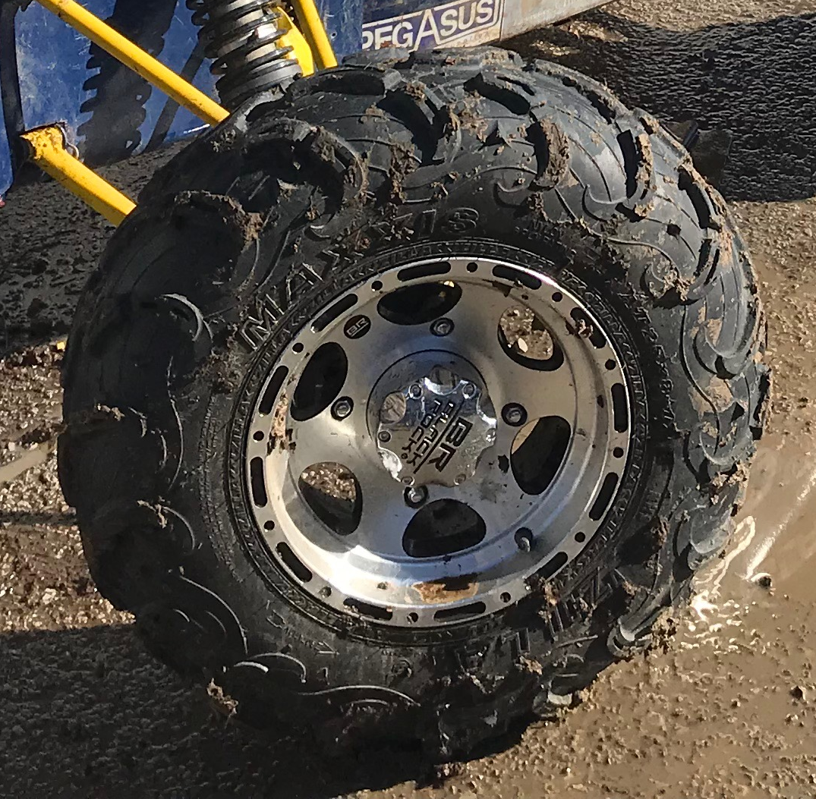
Customer Requirements
Fits geometric requirements to mount to factory wheel rim
Lug bolt heads are secure but easily changed for repairs
Maintains clearance with brake caliper
Interchangeable with factory hub
Lighter than previous year
Cheaper than commercially available part

Slide 4
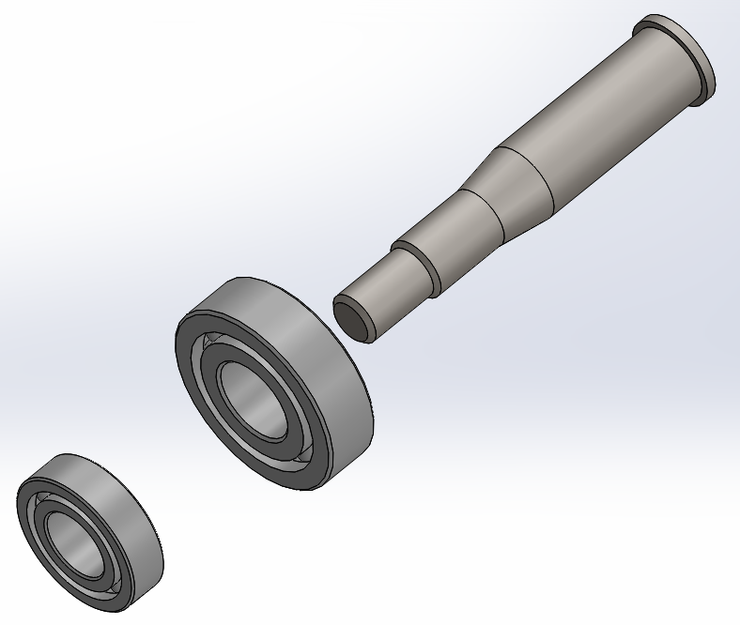
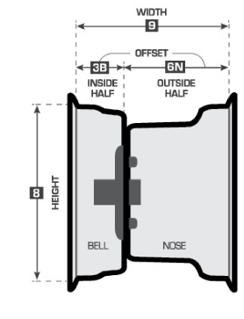
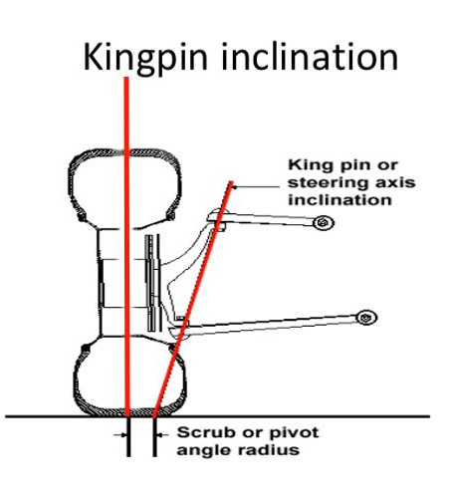
Engineering Requirements
Robust design able to withstand forces exerted on front wheels
Maintains geometry with knuckle to keep optimum wheel contact with ground over bumps and turns
High manufacturability using equipment no more complex than a 3 axis CNC

Slide 5
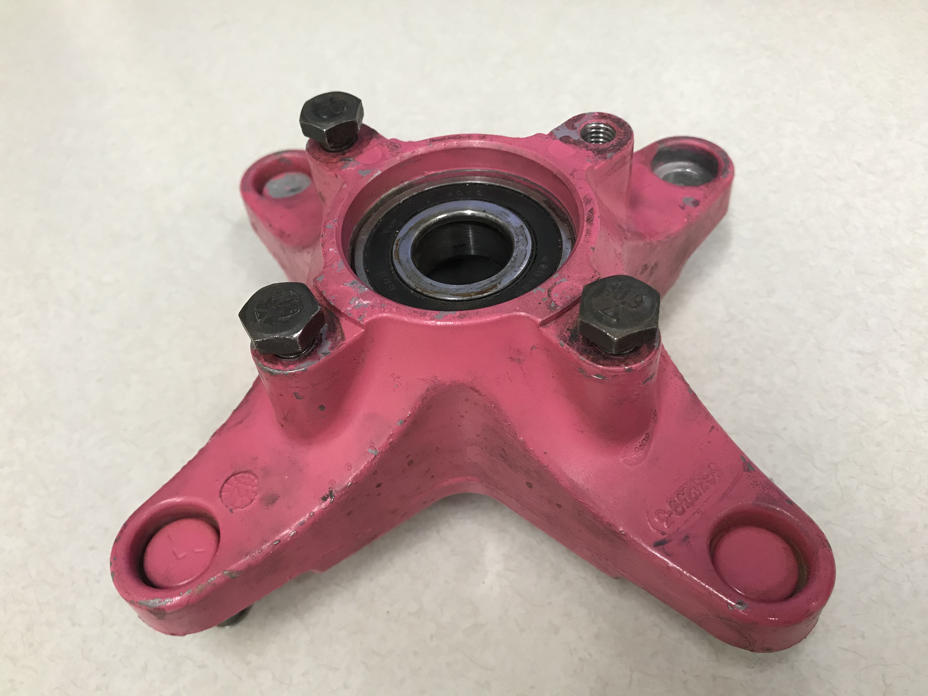
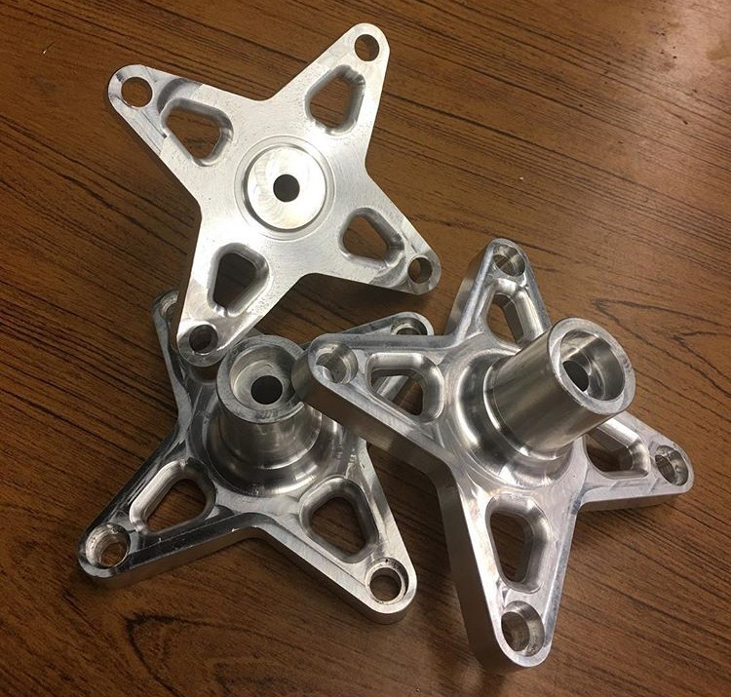
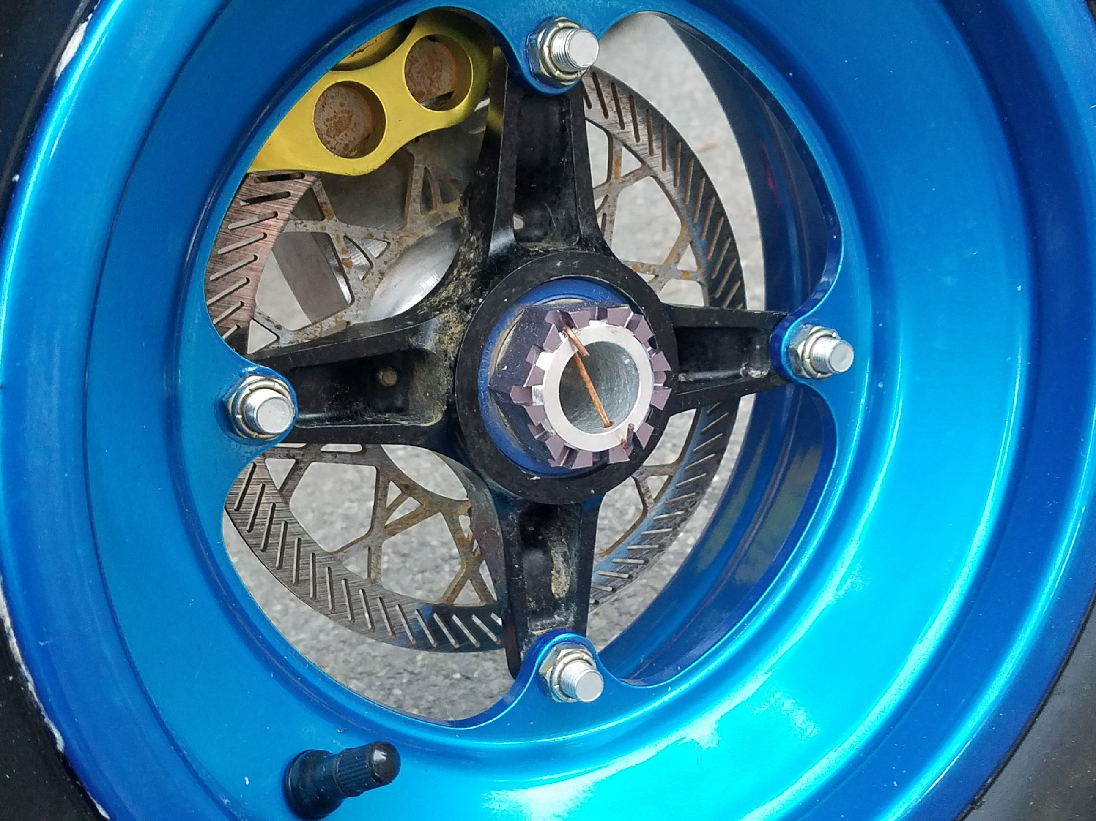
Benchmarking
Last years design was made from 7075-T6 Aluminum, weighed 1.83lbs., and used press fit lug bolts to secure the hub to the rim.
Other teams use cast or milled aluminum on the front with steel hubs in the rear.

Slide 6
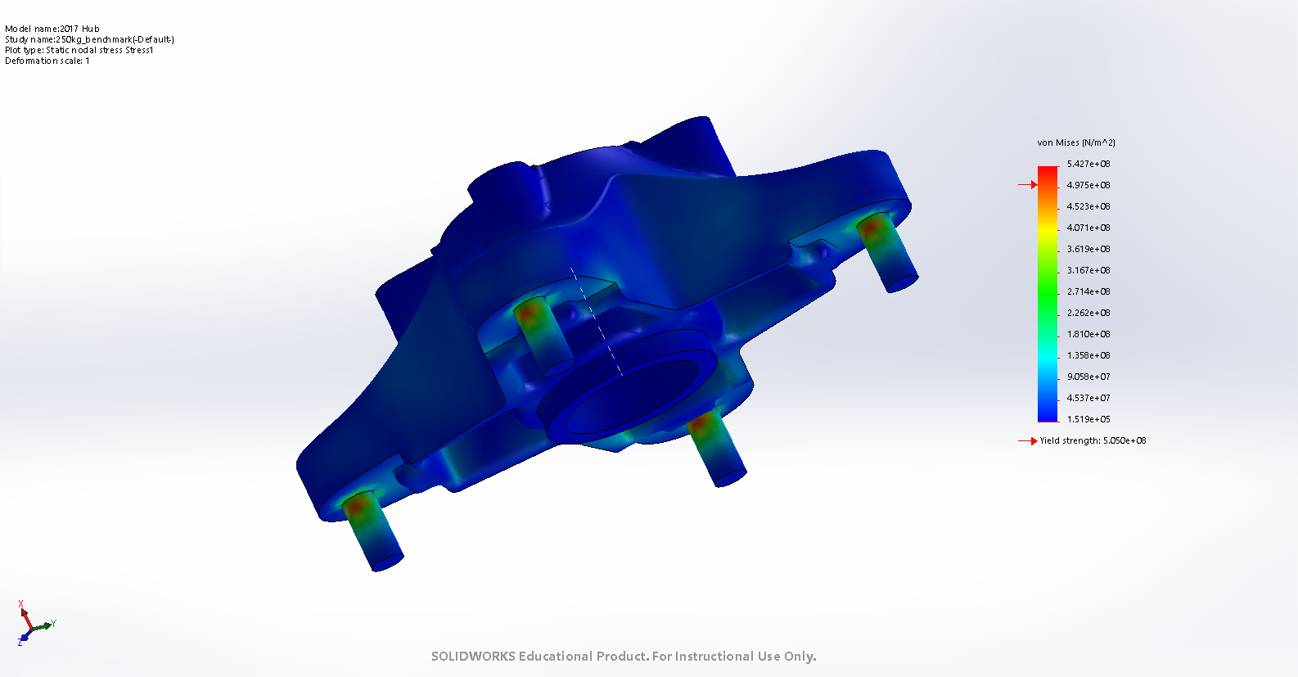
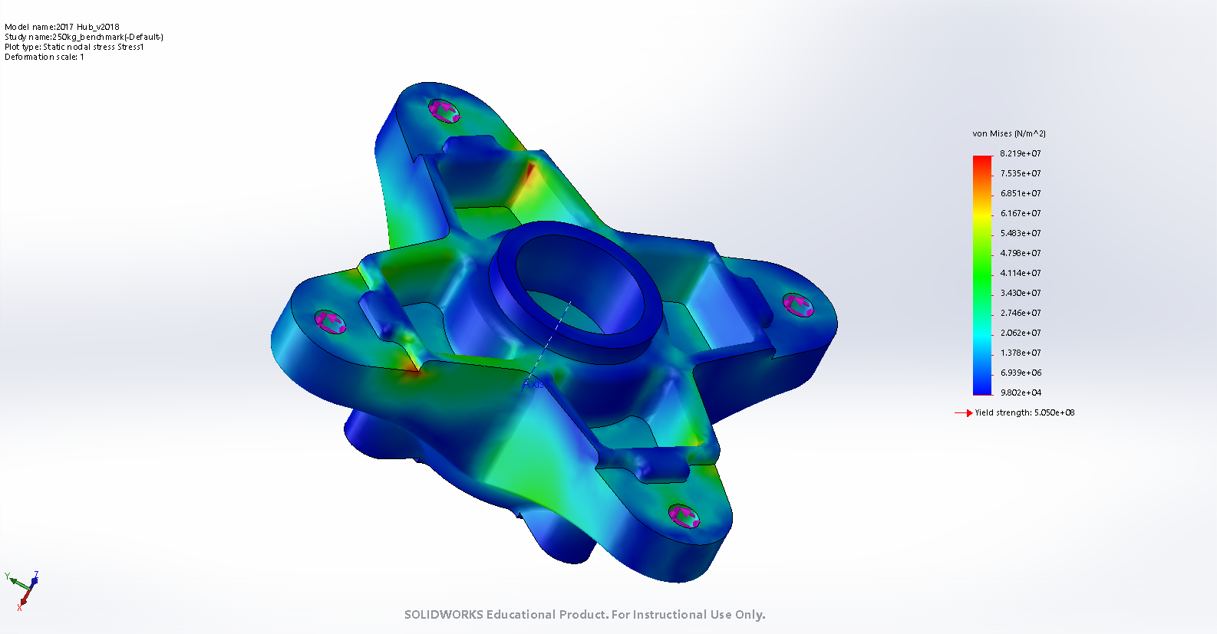
Benchmarking Polaris Hubfront Phoenix part number 0452273
1-2-3 test as ballpark estimate for testing:
1 x Normal Force in Axial Direction
2 x Normal Force in Longitudinal Direction
3 x Normal Force in Vertical Direction
250kg approximates 550lb total weight
Used FS = 2.5
Tetrahedron Mesh of 19225 elements and 31549 nodes
Previous design used lug bolts as mechanical fuses
Low stresses in the part show that this part is well suited and possibly overbuilt for the applied loads.
Results suggest that optimizations could be made to the part by changing material or geometry.
Bolts used Yield at 2.068x10^8 N/m^2

Slide 7
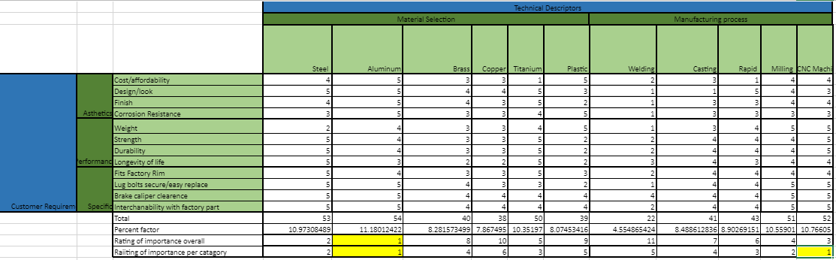
House of Quality: Material and Manufacturability

Slide 8

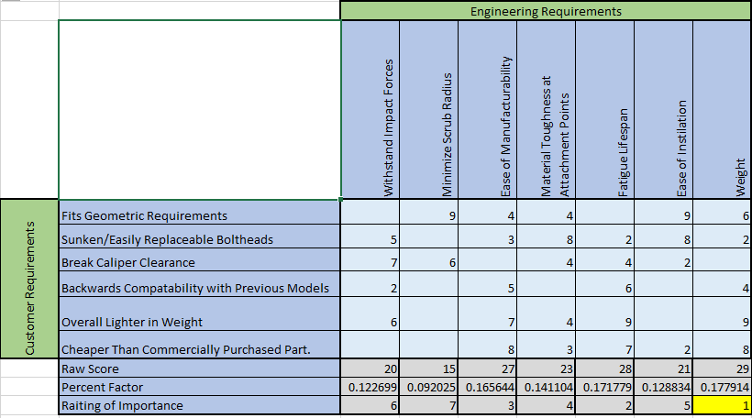



House of Quality: Engineering

Slide 9

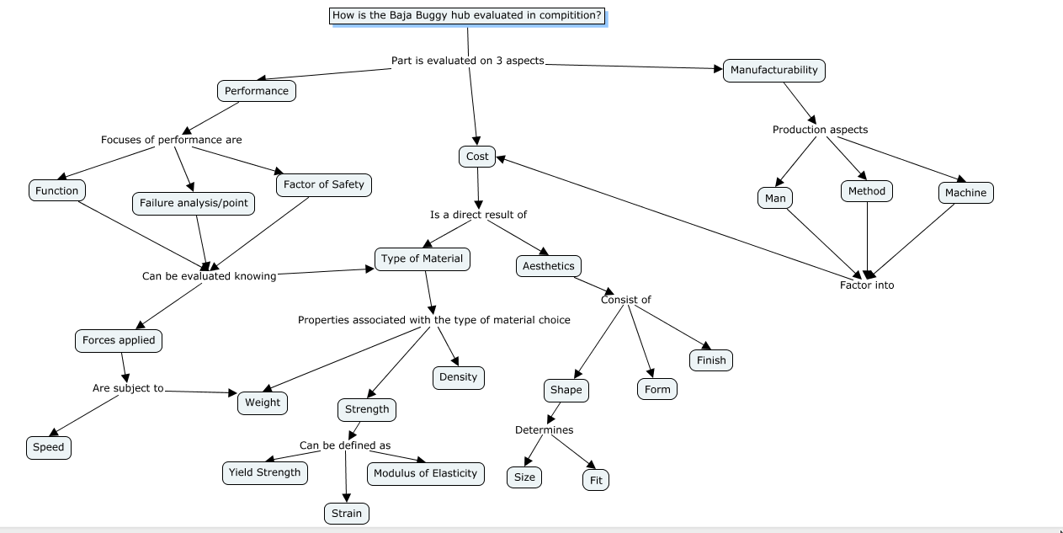

Slide 10
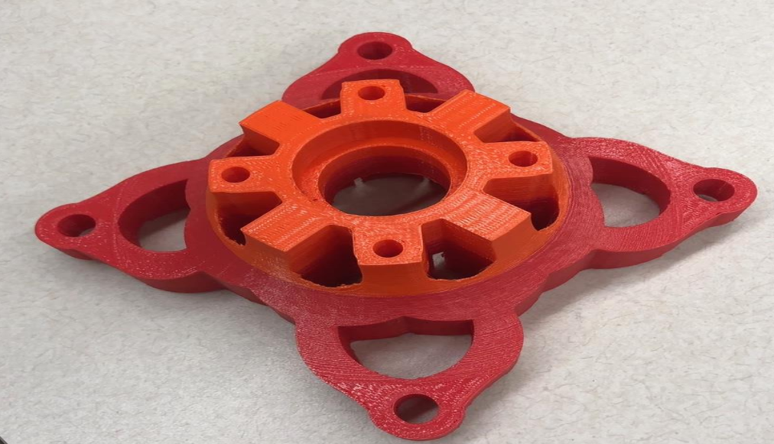
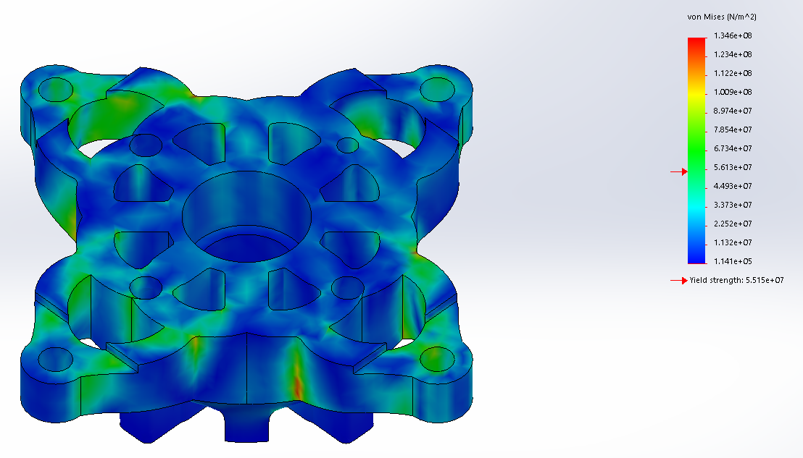
Initial Design 1
Rotor mount holes rotated 45 degrees to align material buildup to arms for additional support with less material.
Minimal material designed with a triangular pattern to help disperse load forces.
Cut straight through design for material removal to make manufacturing cheaper/easier.
Mounting locations designed with backwards compatibility for easy replacement.
7075 T6 Aluminum material choice
Total savings of 30.6% material
Does not withstand forces applied in FEM testing, however material can be removed from core and added to arms to be comparable to FEM on store part.
Force Applied To Mounting Bolt holes: 2.0x10^7 N/m^2
Yields at 5.515x10^7 N/m^2

Slide 11
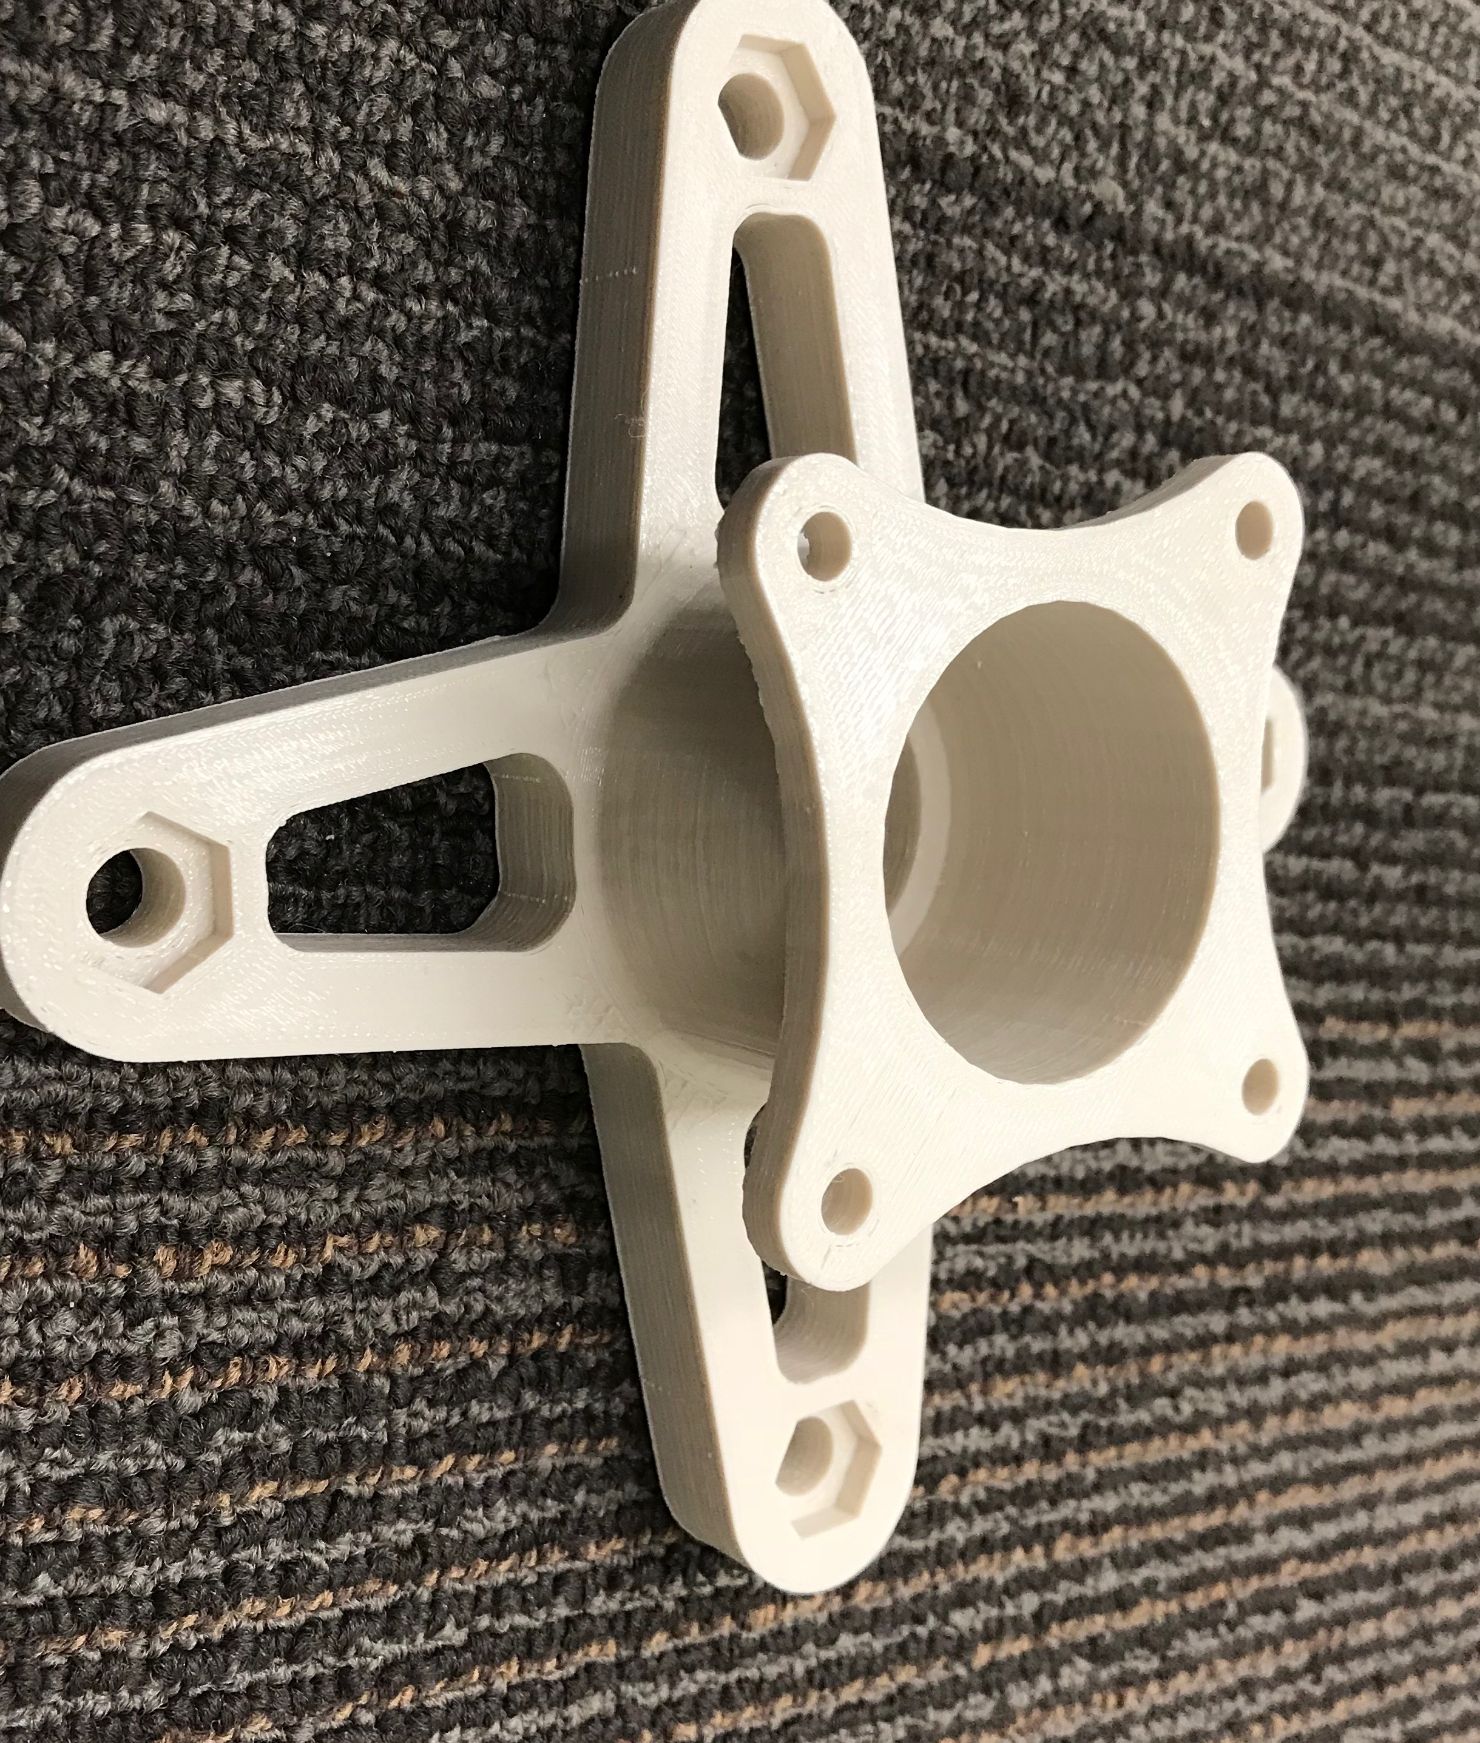
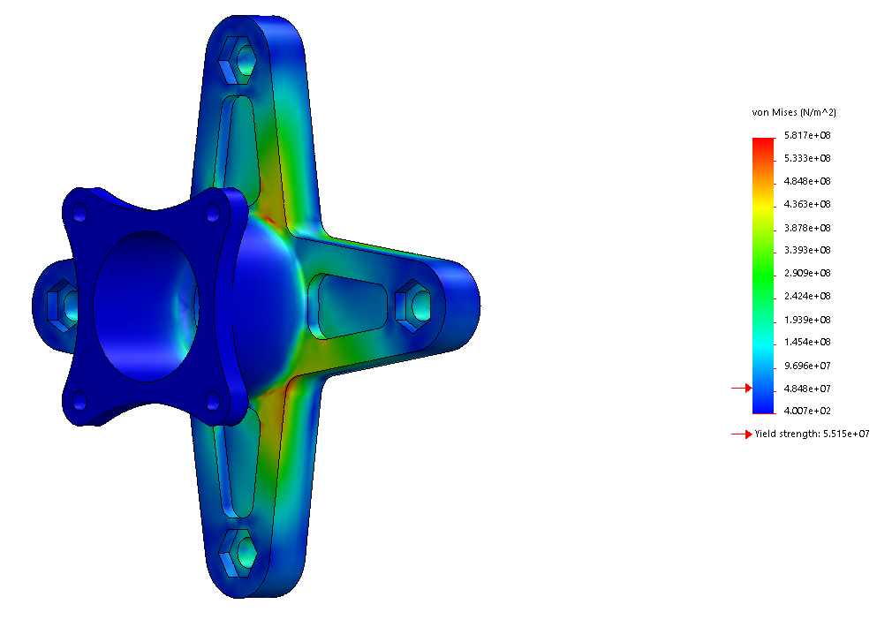
Initial Design 2
Rotates rotor mount holes 45 degrees to make installation and servicing easier.
Added cutaways for bolt heads to be used as lugs without a press fitting
Changed Material from 7075 to 6061 for machinability
Simplified body and removed a lot of material
38% Lighter than original design
Does not fit on existing wheels or lug bolts
Does not withstand forces applied in FEM testing.

Slide 12
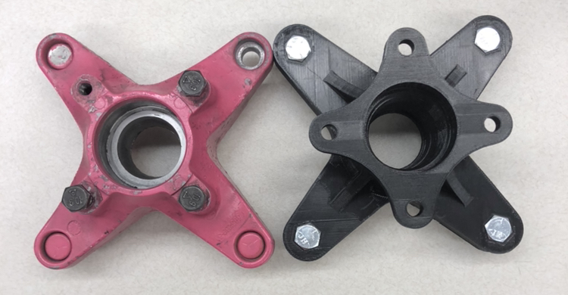
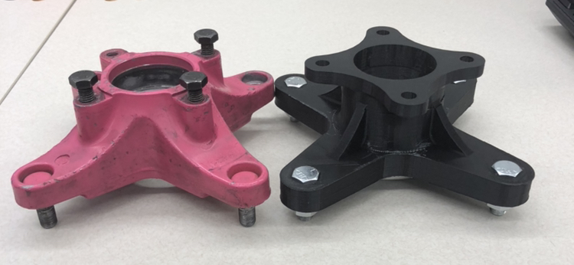
Material Type: 7075 T6 Aluminum
Estimated Tensile Strength: 570000000 N/m^2
Estimated Yield Strength: 505000000 N/m^2
Estimated Weight: 1.42 lbs.
FACTOR OF SAFETY: 2.50
Weight Reduction Percent: 22%

Slide 13
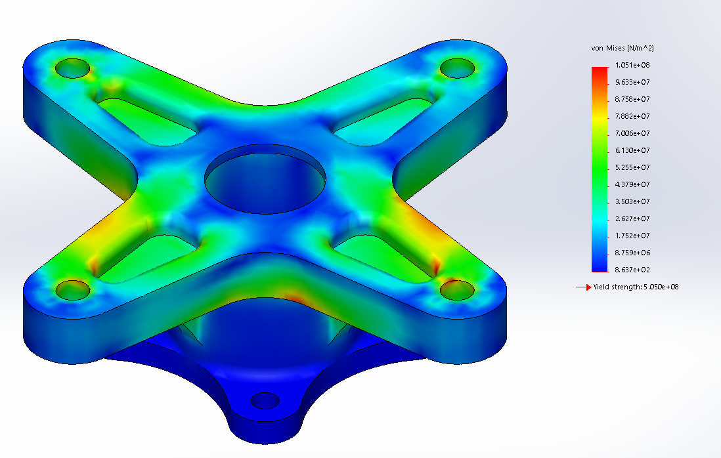
Second Design
Fits Geometric Requirements
Increased fillet radius between support arms
Added support ribs behind support arms with fillets to help with bending
Added fillets in arm relief cuts to reduce stress concentration
Aligned bearing seats to surround wheel centerline
Decreased tolerance on bolt head cutouts

Slide 14
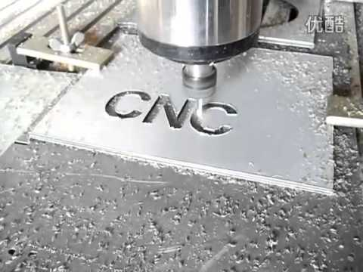
Manufacturability
Thank You Sponsors!
May Manufacturing Inc.
The UMKC Baja Buggy team has acquired sponsors to aid in the manufacturing of custom parts. These parts will be created for only the cost of the material at the price the company pays for it. The total cost of labor to include programming/file type changes, setup time, build time, and post processing time will all be donated free of charge to the Baja Buggy team.

Slide 15
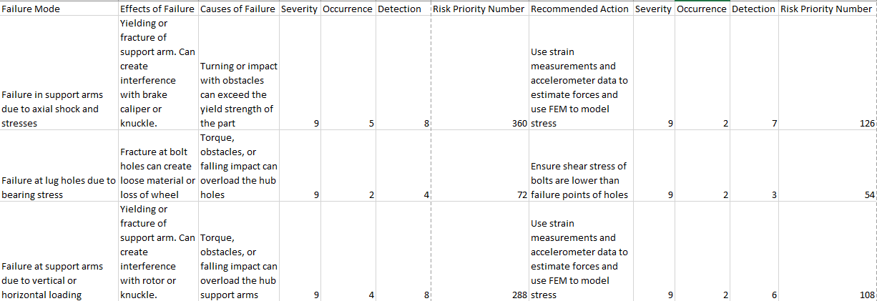
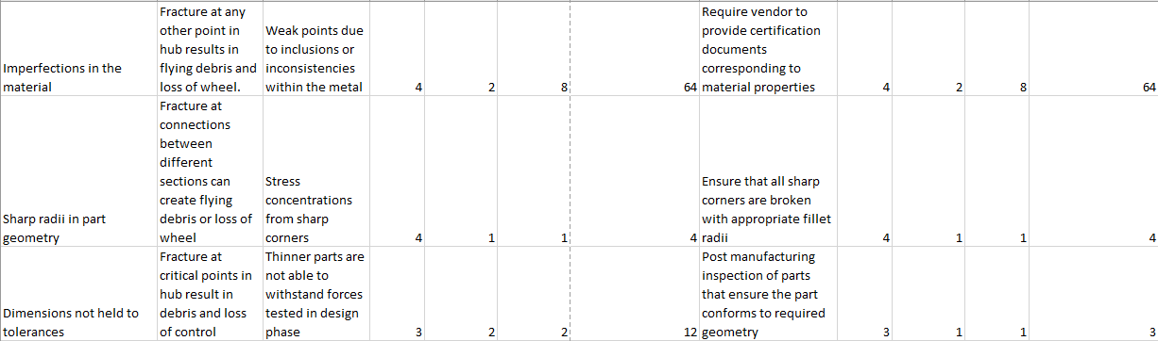
Failure Mode Effects Analysis

Slide 16
Future Work
Design is still in working phase of design.
Wish to rotate mounting arms for brake rotor plate 45 degrees to fully utilize the added rib on both sides of the hub for added torque support.
Design will continue to change/improve as the other parts of the Baja Buggy are improved.
Part will be manufactured, tested and used in Baja competitions for the 2018-2019 competition year!
Cost analysis and quote from a competitive vender will be included in the final copy of the report.

Slide 17
Questions????

